Slide 1


Slide 2


OUTLINE
What is Ansible ?
Real Life Use Cases
Ansible Architecture
Comparable Tools
Hands on

Slide 3

What is Ansible ?
Tool to automate IT tasks.
What is IT tasks ?
Why we automate it ?

Slide 4


Real Life Use Cases
Update java version

Slide 5

Real Life Use Cases
Repetitive Tasks
Updates
Backup
System reboot
Create
user
Assign Groups
Assign Permission

Slide 6




Real Life Use Cases
What did I do the last time ?

Slide 7

Real Life Use Cases
More Efficient
Less Time consuming

Slide 8




In 4 Different Ways
Execute task from your own machine
Configuration/Installation/Deployment steps in a single YAML file
Re-use same file multiple times and for different environments
More reliable and less likely for errors

Slide 9
Ansible Architecture
Modules
=
Small Program that do the actual work.

Slide 10
Modules
Module
Module
Module
Module
Module
Get push to the target server.
Do their work and get removed.

Slide 11
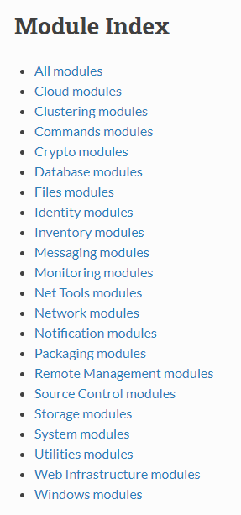
Modules
Create DB table
Create user
And hundreds more ...
Module = One Small Specific task
Start Nginx Server
Create or Copy file
Install Nginx Server

Slide 12
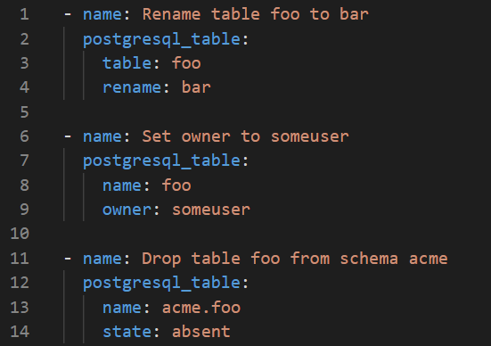
Ansible Uses YAML
No need for learning a specific language for ansible
Rename table :
Set user privilege :
Drop table :

Slide 13


Ansible Playbooks
Modules are specific.
Module A
Module B
Module C
Module D
Module E
So how to handle complex application ?
Multiple modules
In a certain sequence
Ansible Playbooks
Grouped together

Slide 14
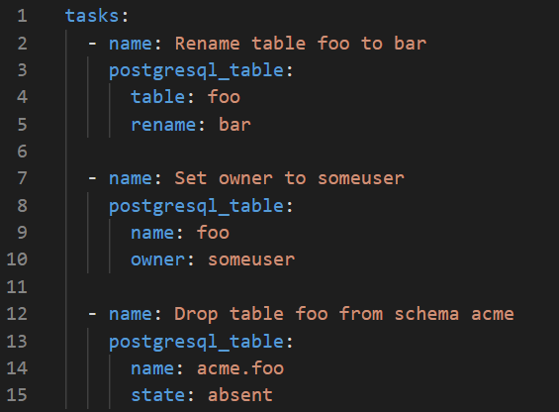
Ansible Playbooks
Tasks
1 task = action to perform
Module name
Arguments
Description of task
Where should these tasks execute ?

Slide 15
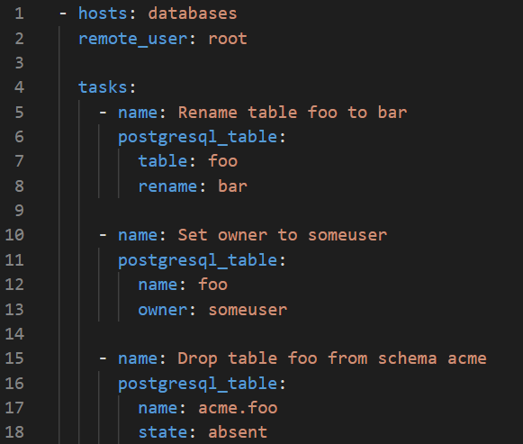
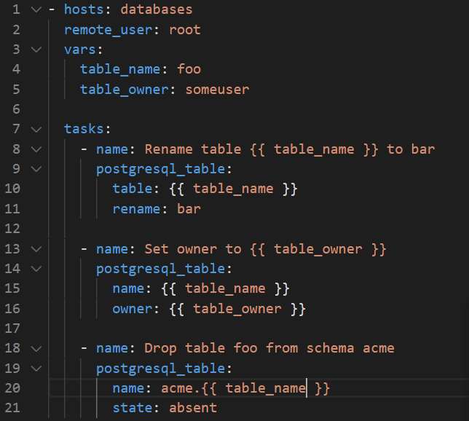
Ansible Playbooks
Where should these tasks execute ?
HOSTS
With which user should the tasks execute ?
REMOTE_USER
Using variable for repeating values

Slide 16

Ansible Playbooks
PLAY
Which tasks
Which hosts
Which user

Slide 17
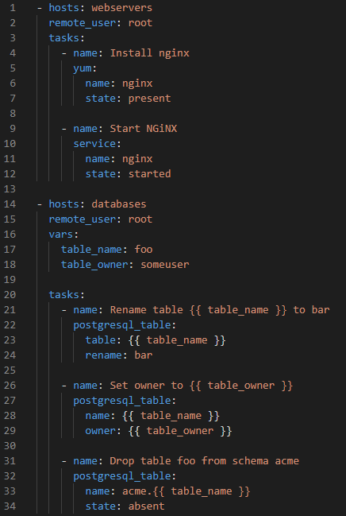
Ansible Playbooks
PLAYBOOKS
=
one or more PLAYS
=
Orchestrates
the module execution

Slide 18
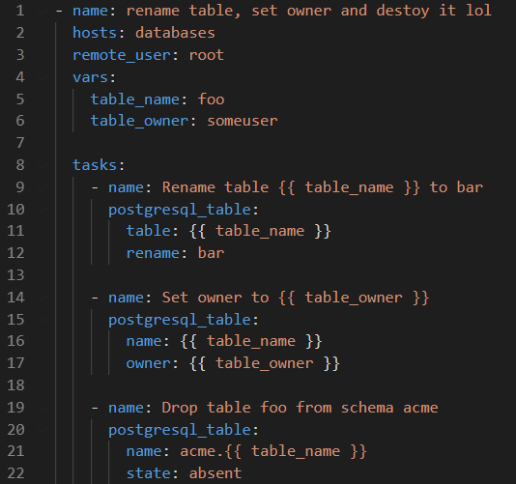
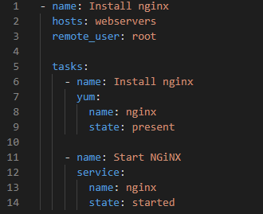
Good Practice : Naming Plays
Where do the hosts values come from ?

Slide 19
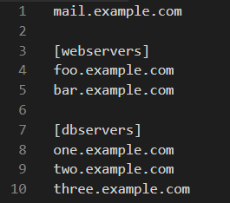


Ansible Inventory
Host file
Groups multiple IP/hostname
Inventory = all the machines involved in task executions

Slide 20
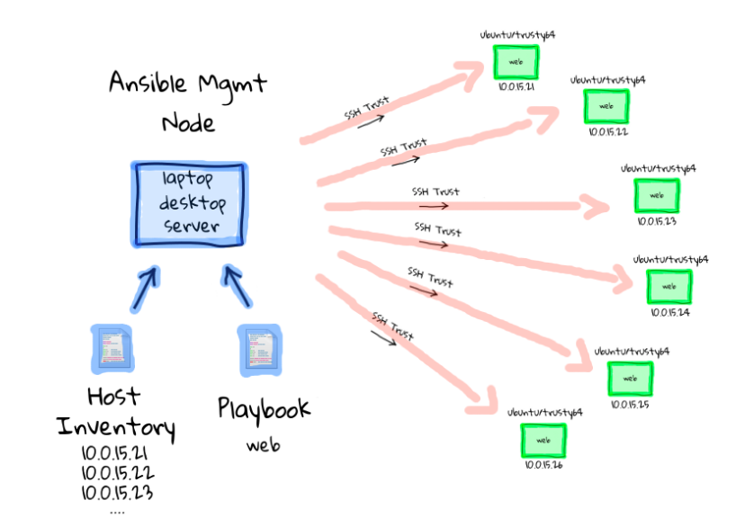
Ansible Architecture

Slide 21
Comparable Tools
ANSIBLE
CHEF and PUPPET
Simple YAML
Agentless
Ruby more difficult to learn
Installation needed
So need for managing updates on target servers

Slide 22
Summary
Automation tools make sense for complex environments
Prevent human error
Prevent manual work

Slide 23

Hands on

Slide 24
Installation
Step 1: Install python
$ sudo yum install -y python
Step 2: Install the EPEL Repository
$ sudo yum install –y epel-release
Step 3: Install ansible
$ sudo yum install –y ansible
Step 4: Verify installation
$ ansible --version

Slide 25

Testing
Step 1: Try run ansible ansible ad-hoc command
$ ansible localhost –m ping
Step 2: Using inventory file
$ ansible all –m ping –i hosts –-ask-pass
Step 3: Setup module
$ ansible all -m setup -i hosts --ask-pass
Step 4: using module arguments
$ ansible all -m setup -i hosts --ask-pass –a “filter=ansible_distribution*”

Slide 26

Playbooks
Step 1: Create playbook to install nginx
- name: Install nginx
hosts: webservers
remote_user: root
tasks:
- name: Install nginx
yum:
name: nginx
state: present
- name: Start NGiNX
service:
name: nginx
state: started

Slide 27
Playbooks
Step 2: Run your playbook
$ ansible-playbook webserver.yaml –i hosts –-ask-pass
Step 3: Verify if nginx running on target server
$ ps aux | grep nginx
Step 4: Can you open it using browser ?

Slide 28
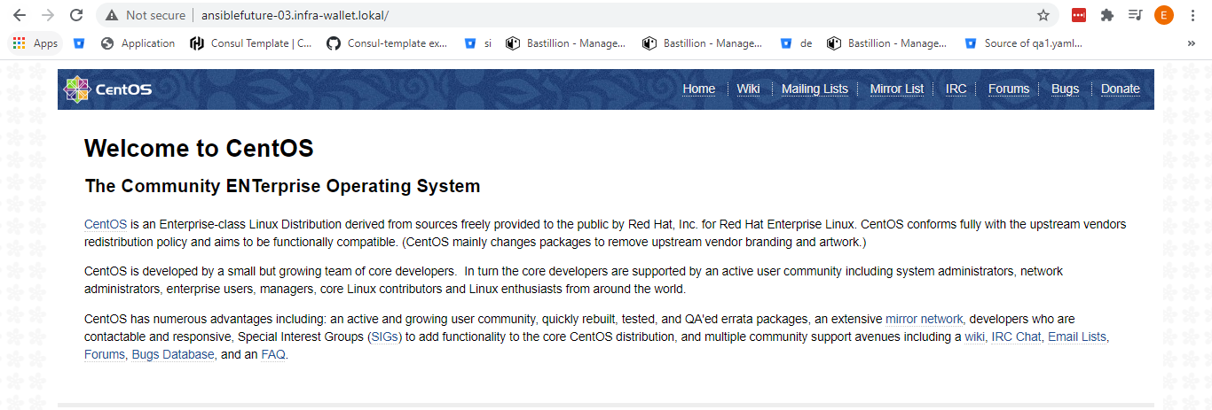
Task 1
Update your playbook to make your nginx can be accessed using browser

Slide 29

Automation user
Security dude told us that we cannot use root user as remote user, so we need to create new user to running ansible.

Slide 30
Automation user
Step 1: Create user ansible
$ sudo useradd ansible
Step 2: Add user ansible to the wheel group
$ sudo usermod –aG wheel ansible
Step 3: Set password for ansible user
$ sudo passwd ansible
Step 4: Run commands above to all managed nodes as well

Slide 31
Testing new user
Step 1: Login as ansible user
$ su ansible
Step 2: Try ansible ad-hoc command
$ ansible webservers –m ping –I hosts –ask-pass
Step 3: Try ansible playbook command
$ ansible-playbook webserver.yaml –i hosts –-ask-pass

Slide 32
SSH KEY Configuration
Hmm...its hard if we keep insert password when running ansible

Slide 33
SSH KEY Configuration
Step 1: Login as ansible user
$ su ansible
Step 2: generate SSH key on the control node
$ ssh-keygen
Step 3: Copy SSH public key to all managed nodes
$ ssh-copy-id ansible@node1.example.com
Step 4: Try to login without password
$ ssh ansible@node1.example.com

Slide 34
Testing without -–ask-pass
Step 1: Login as ansible user
$ su ansible
Step 2: Try run playbook without --ask-pass
$ ansible-playbook webserver.yaml –i hosts

Slide 35
Ansible Configuration files
Step 1: Default configuration file
$ cat /etc/ansible/ansible.cfg
Step 2: Default hosts file
$ cat /etc/ansible/hosts

Slide 36

Task 2
Another security dude told us that running nginx on port 80 is insecure because its to obvious. We need to change it to 40080.
Please update your playbook !!

Slide 37
Challenge
Add a page to webserver, that can show the IP of the webserver we access.

